Slide 1
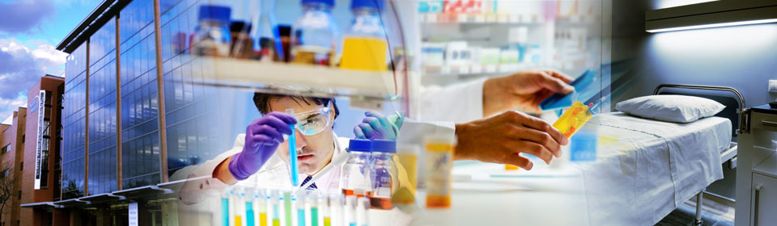
From the Bedside to the Benchside:
An Introduction to Bench Research
February 13, 2018

Slide 2
The Feinstein Institute for Medical Research – Northwell Health / Manhasset Campus
Mabel N. Abraham, PhD
  Research Scientist
    Pediatric Research Lab
Julien Papoin, MS
  Research Associate
    Pediatrics Hematology/Oncology Lab
Champa N. Codipilly, PhD
  Associate Investigator
    Lilling Family Neonatal Research Lab

Slide 3


Slide 4
Lab Bench Research
Assays and Instruments
Analyzing Biological Matrices:
    Biological Fluids
      Saliva
      Whole Blood
      Urine
      Stools
    Cells/Tissues
  Analyzing Bacteria
  Analyzing Genetic Material: DNA/RNA

Slide 5
Analyzing Biological Matrices
Cell Number Analysis
  Whole Blood
    Complete Blood Counts
Measure Protein Abundance
  Whole Blood
    Serum
    Plasma
  Urine
  Cells/Tissue
RNA/DNA Analysis
  Whole Blood
  Cells/Tissue
  Bacteria

Slide 6
Measurement of Cytokine Levels
Changes in circulating cytokine and chemokine levels
  Associated with many human diseases, and thus understanding the relationships between these changes and disease is an important area of medical research.
Following collection, plasma or serum should be cryopreserved at -80º C.
Cytokines and chemokine levels can be measured by ELISA.

Slide 7
Measurement of Cytokine Levels – ELISA - Enzyme-Linked Immunosorbant Assay
Primary Antibody
Secondary Antibody
1. Antigens coated onto the ELISA plate.
2. Serum/sample containing primary antibodies is added.
Chromogen
3. Non-antigen binding antibodies are washed off the plate.
4. Secondary antibody-conjugated with an enzyme is added.
5. Excess secondary antibody is washed off the plate.
6. Substrate for the enzyme (chromogen) is added.
7. Enzyme reacts with the substrate, producing color. Color intensity correlates with level of antigen binding.

Slide 8
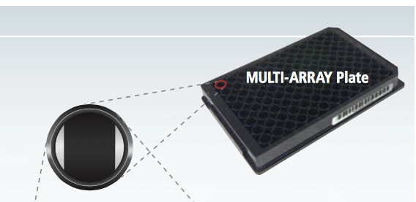
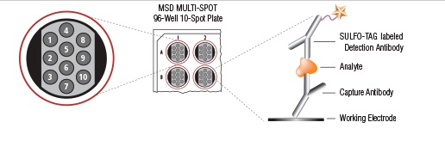

Multiplex ELISA using Meso Scale Discovery (MSD)
MSD’s spot patterns are the hallmark of its MULTI-ARRAY technology – biomarker detection in single and multiplex formats.
Electrochemiluminecence -SULFO-TAG labels - emit light upon electrochemical stimulation initiated at the electrode surfaces.

Slide 9
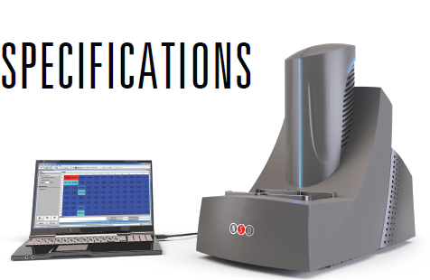
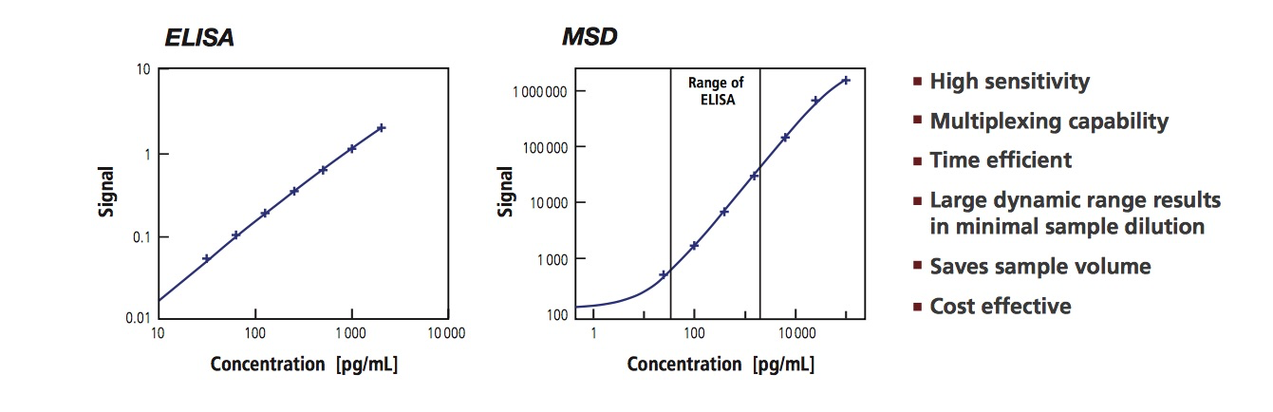
ELISA versus MSD
Customizable assay to test for many cytokines in a single volume of sample.
MESO QuickPlex SQ 120

Slide 10
Measure Protein Abundance in Cells/Tissue
Total cells/tissue lysates.
Denatured protein is electrophoresed and separated based on size in a gel matrix.
Proteins are transferred to a membrane, blocked and probed with an antibody specific for interested protein targets.
Identify protein expression level changes using Immunoblot Analysis also known as Western Blot.

Slide 11
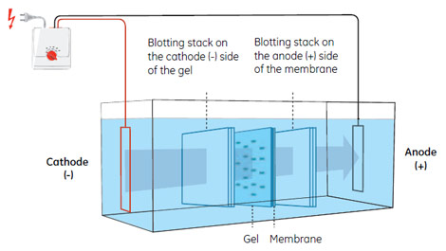
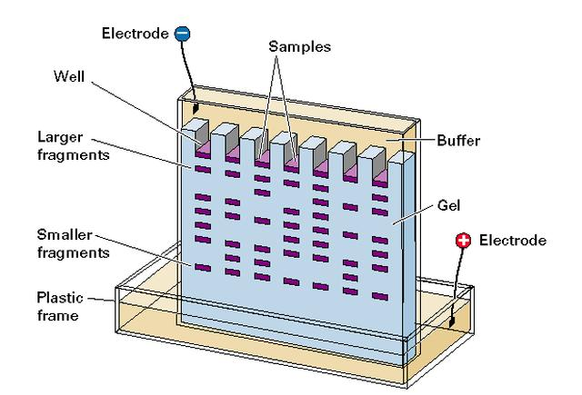
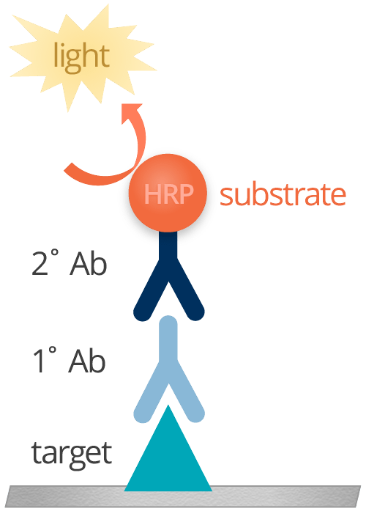
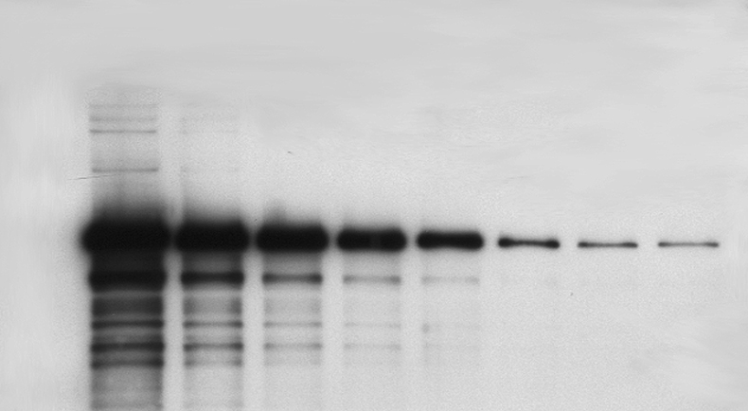
Western Blot workflow
SDS Polyacrylamide Gel Electrophoresis (SDS -PAGE)
Membrane Transfer
Antibody Signal Target
Electrophoresis
Western Blot Image

Slide 12
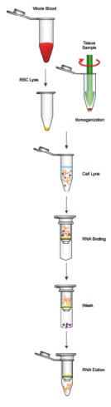

Total RNA Preparation from
Bacteria, Cells/Tissue or Whole Blood
Applications
  RNA Sequencing
  Quantify Gene Expression - QPCR
Spin Column Technology

Slide 13

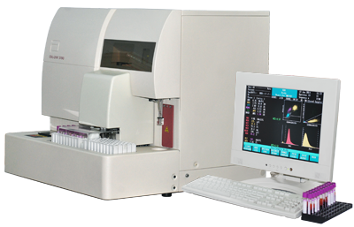
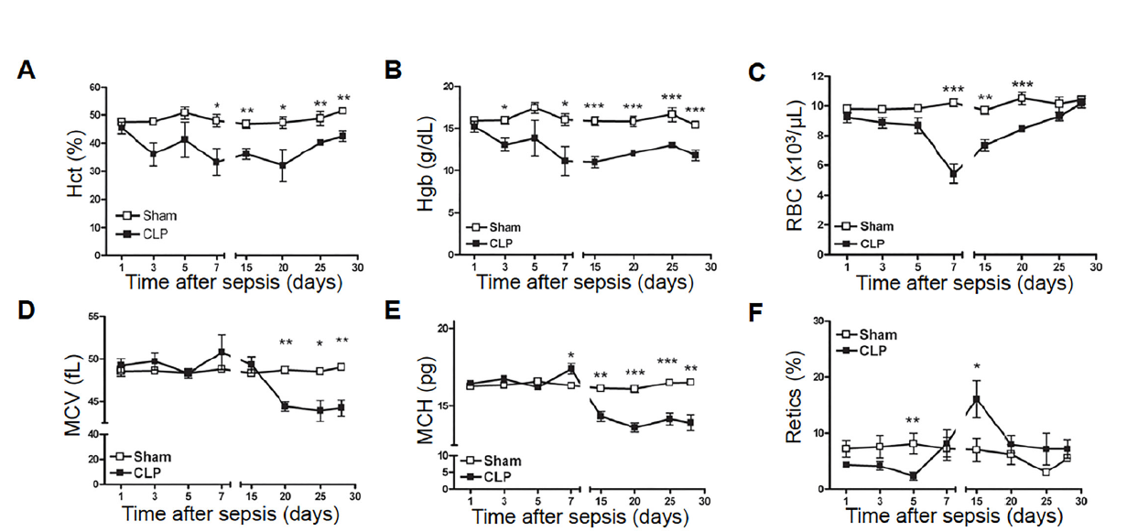
Analyzing CBC’s in Whole Blood
BLOOD
MOUSE MODEL OF DISEASE
Example of Anemia
What causes it?

Slide 14
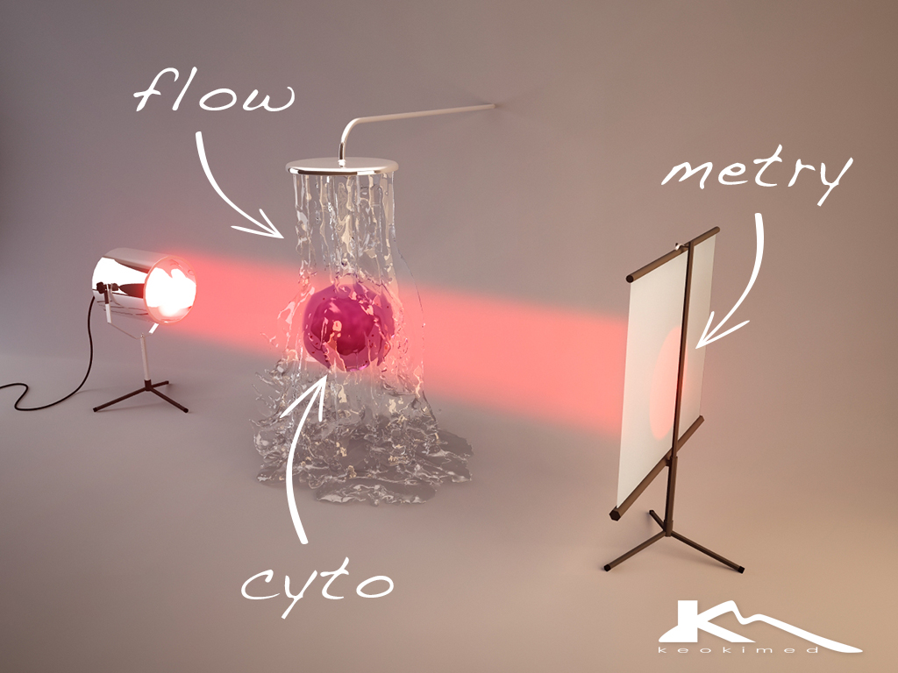
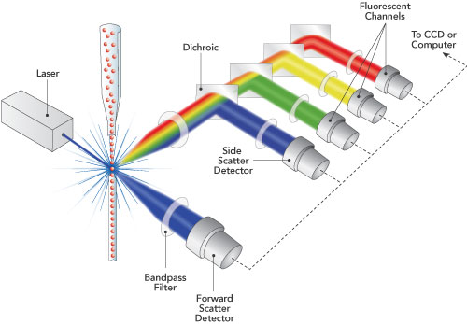
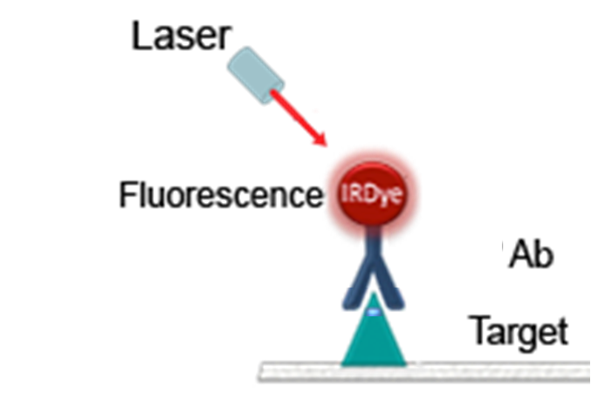
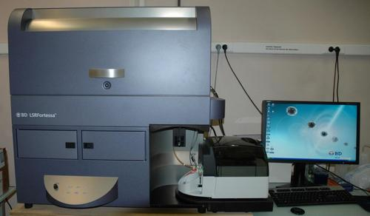
Analyzing Specific Cell Populations Using Flow Cytometry
Antibody Labeled Cells
Fluorescence Intensity
Size (FSC)
CELL
Fortessa – Flow core Facility - 2d Floor

Slide 15
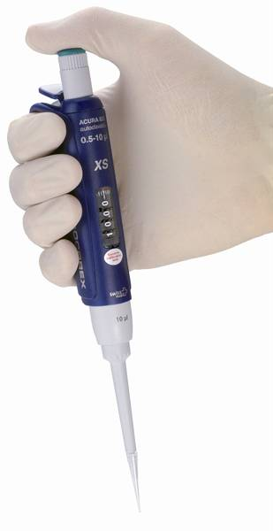
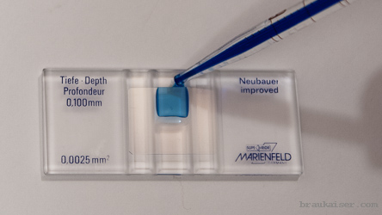
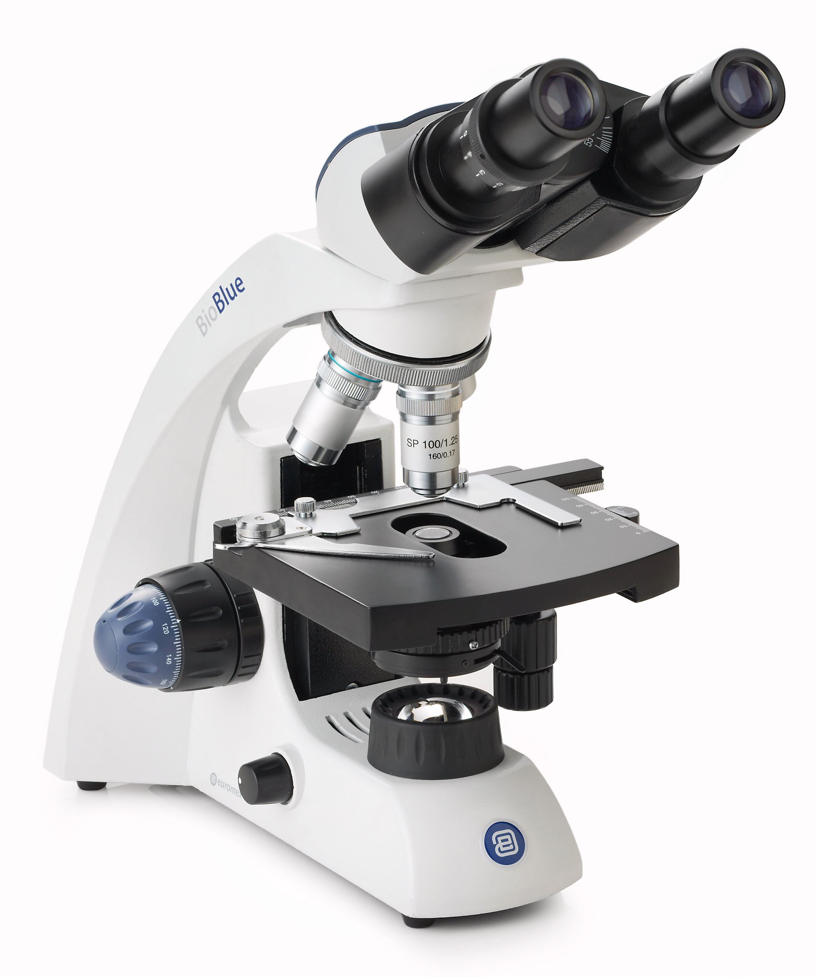
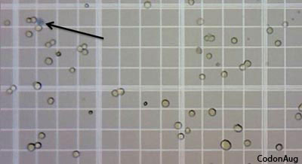
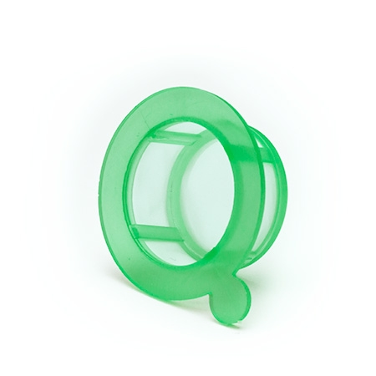
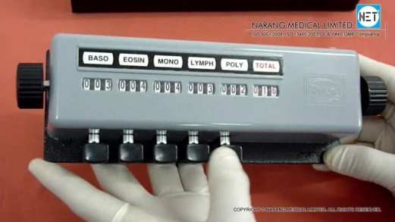
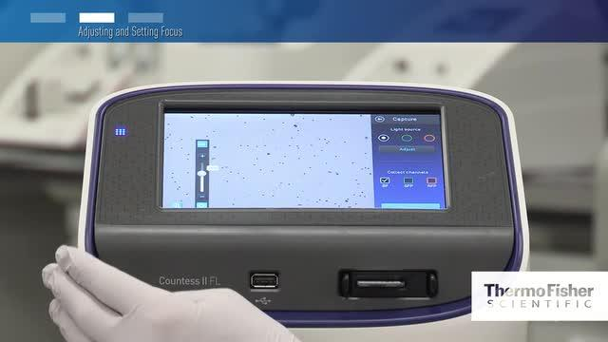
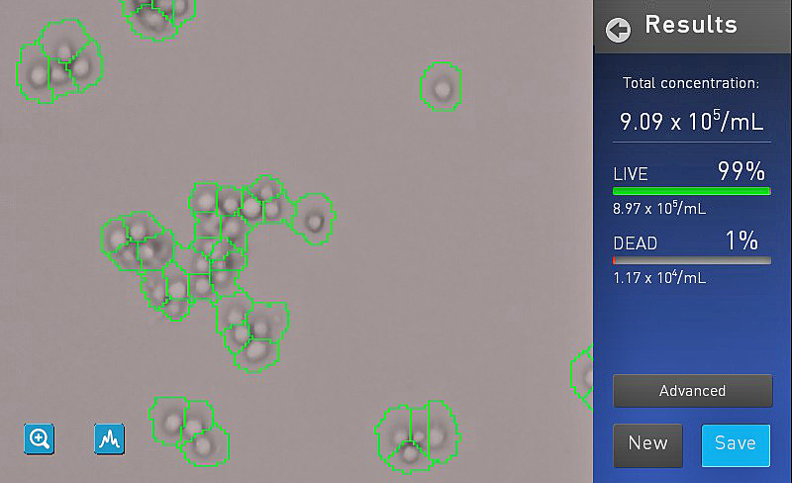
Sample Preparation
-Counting Cells Using Hemocytometer-
10uL transferred to Hemocytometer
Filtration to
single cell
suspension
#.10⁶ cells/mL

Slide 16

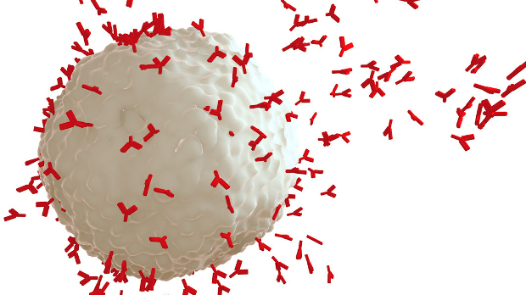
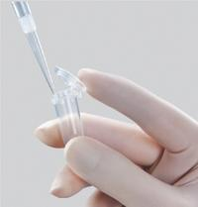
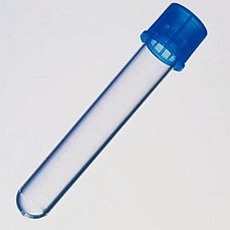
Flow Cytometry
-Antibody Labeling-
Antibodies
Cell
Wash
Add Fluorophore conjugated Antibodies and Incubate
Transfer to Flow cytometry tube
Take 1.106 Cells into a microtube
Use with flow cytometer

Slide 17
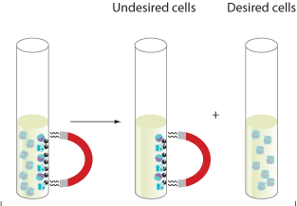
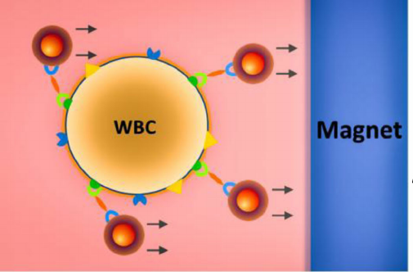
Isolating Cell Populations Using Magnetic Depletion
Example: Lymphoid cells depletion with the CD45 marker
Ratio beads / number of cells
lymphoid
Erythroid cells

Slide 18


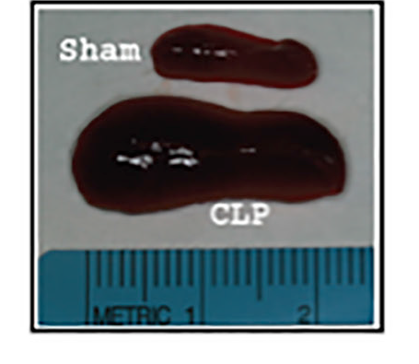
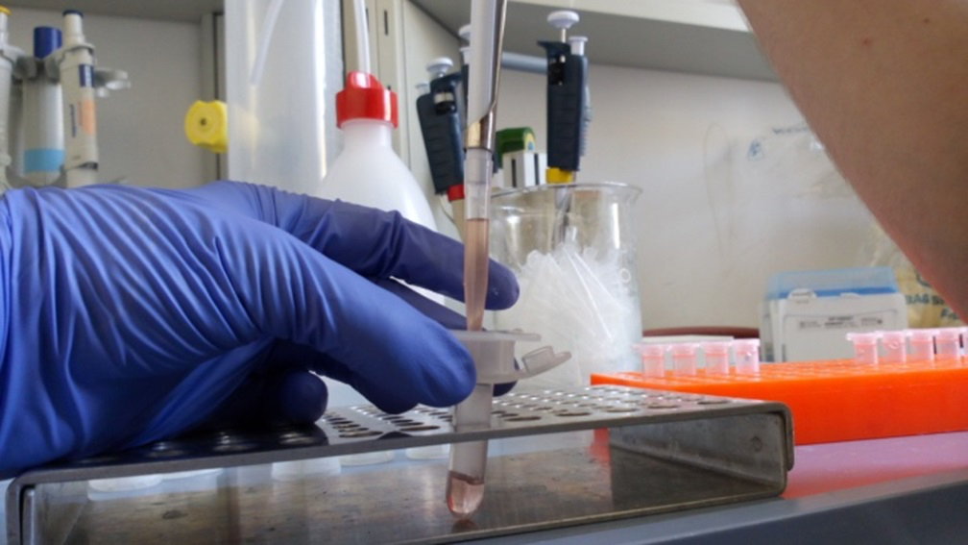
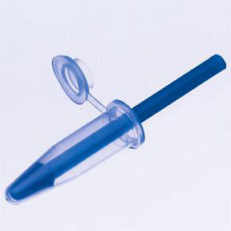
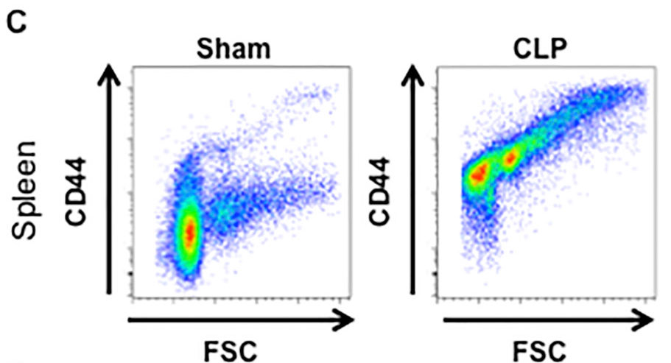
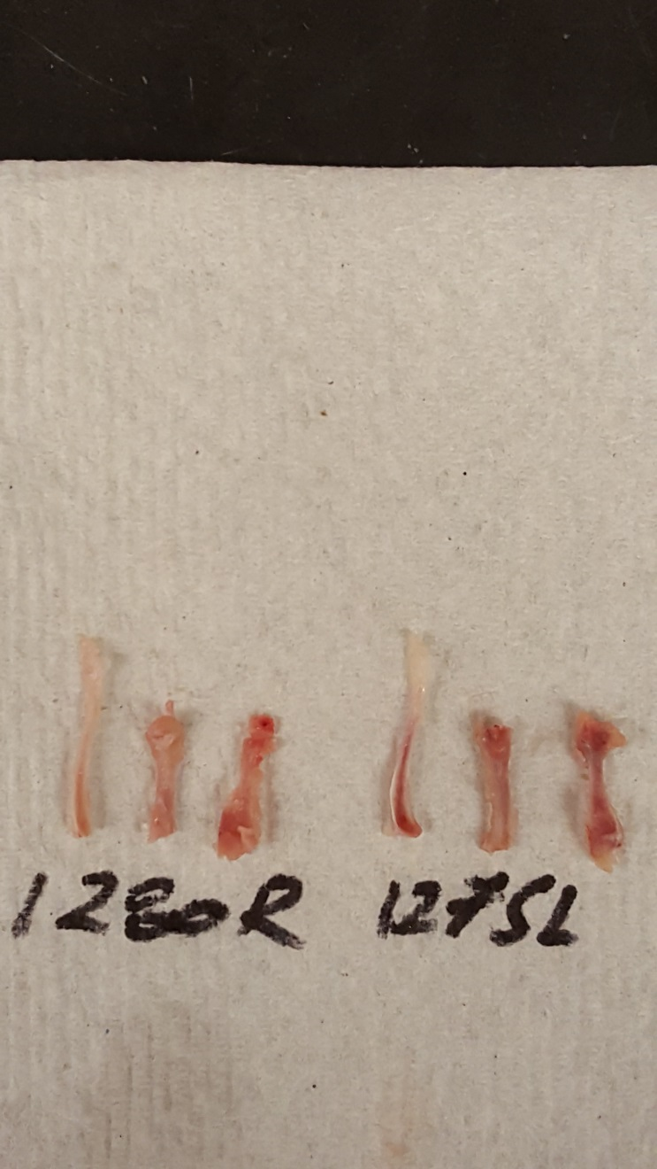

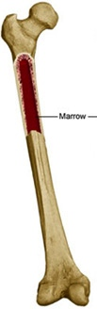
Example: Anemia in a septic mouse
BLOOD
CLP MOUSE
Homogenization
Myeloid cells depletion (anti CD45 Beads)
Cell
counting
Spleen
Bone Marrow
Erythroid precursors Antibody Staining
(Ter119 -/ CD44+)
Flow cytometry

Slide 19
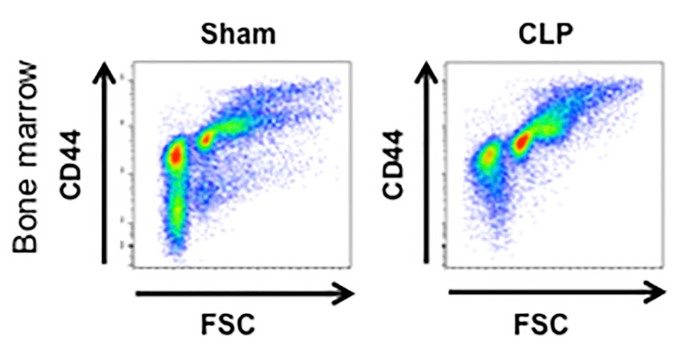
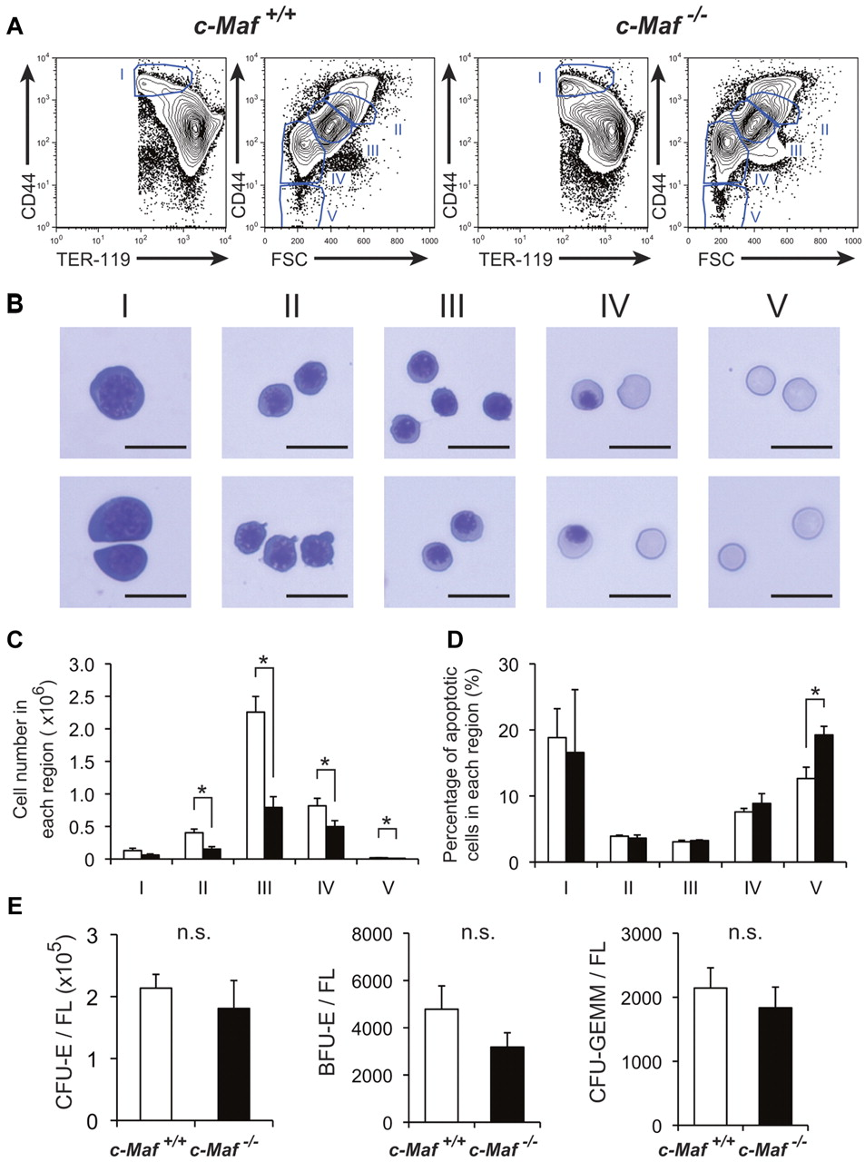
Flow Cytometry Results
-Quantifying Cell Populations-
Example: Anemia in a septic mouse.
I
More late RBC precursors
II
III
IV
Less RBC
CD44
V
Presence of
RBC precursors
FSC
Less RBC
Serum HMGB1 protein increased in CLP animals.
Injection in healthy animals causes same symptoms.

Slide 20
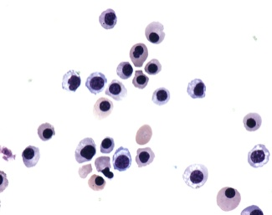
In-vitro cultured Human Cells
Example : Effect of HMGB1 on erythropoiesis
Cultured human HSCs with
human recombinant HMGB1
Flow Cytometry
Similar results as the mouse
Cell Lysate for protein extraction
Western Blot (Cellular Pathway affected)
DNA Sequencing
Unknown Gene expression affected ?
RNA extraction
QPCR (Pathway affected at the Transcript level)

Slide 21
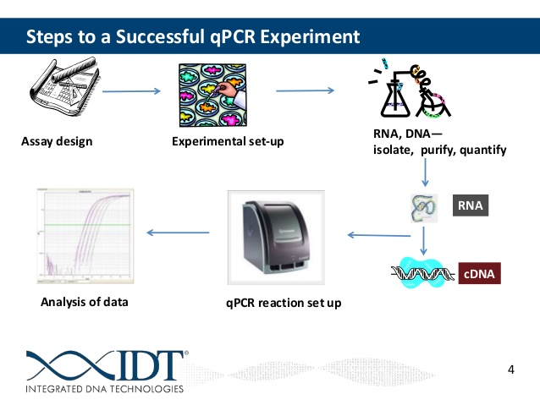
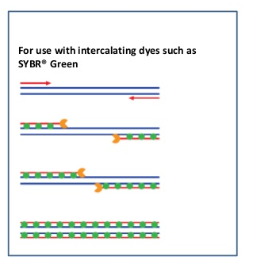
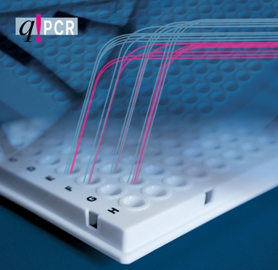
Gene Expression Analysis
- Transcriptional level: QPCR -
Real time monitoring of the reaction
cDNA
Amplification
Cycles
Reverse Transcription
Fluorescence
SYBR Green

Slide 22
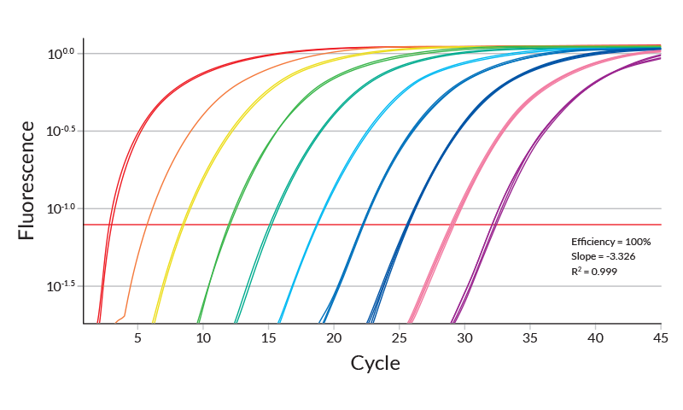
Gene Expression Analysis
- At the Transcriptional level: QPCR -
QPCR – Real time quantification of mRNA transcription levels
High abundance of
transcript in the cells
Low abundance of
transcripts in the cells
(more cycles required
to obtain an amplification)
1
32

Slide 23
Methods to identify Bacteria
Culture based
  Using agar plates/broth
Non-culture based
  PCR –an end point result
  QPCR – relative expression (between two samples)
  DNA Sequencing (to study individual genes, full chromosomes or entire genomes. Also provides the order of individual nucleotides present in molecules of DNA or RNA

Slide 24
Culture vs. non-Culture
Culture based
  Absolute number
    Colony Forming Units/mL (CFU/mL or CFU/g)
    eg: 2x10⁶ CFU/mL of lactobacilli in human milk
Non-culture based
  Prevalence of a specific organism
  Ratios
  In QPCR, fold change or an increase or a decrease of the target molecule
  ***Whether dead or alive, DNA can be extracted

Slide 25
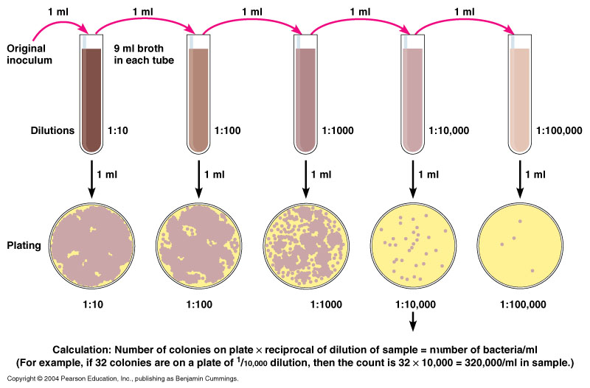
Culture Techniques
Bacteria plating

Slide 26
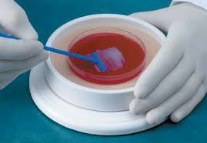
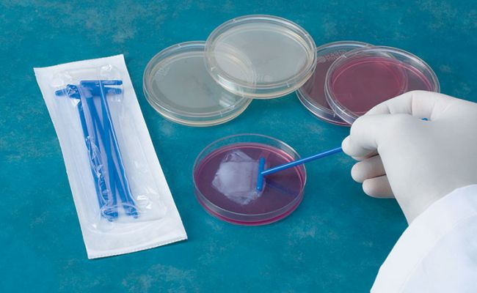
Culture Techniques
Bacteria plating

Slide 27
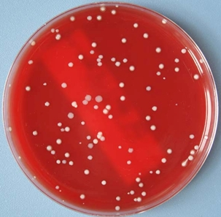
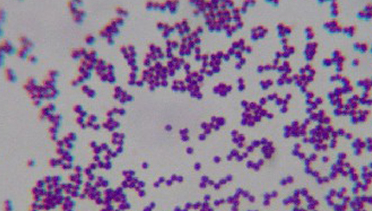
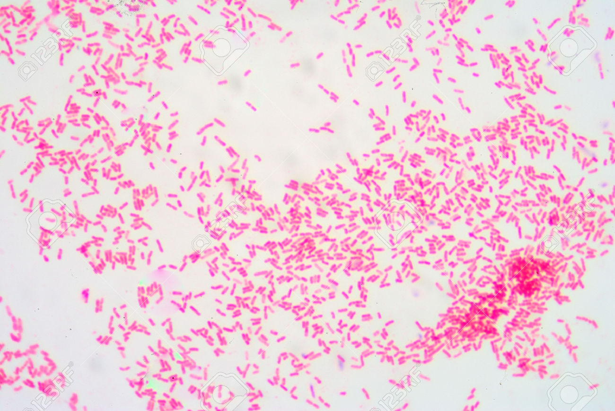
Illustrations
Agar plate with colonies
Gram Positive stain
Gram negative stain
GROWTH
STAINING

Slide 28
Non Culture Techniques
PCR/QPCR (polymerase Chain Reaction/ Quantitative Polymerase Chain Reaction)
Sequencing
  For both techniques DNA need to be extracted, and isolated
  Different DNA extraction kits are available depending on the source (eg: stools, saliva)
  Concentration of the DNA will be measured
  PCR will be carried out to differentiate bacterial and Human DNA and for differentiate species

Slide 29
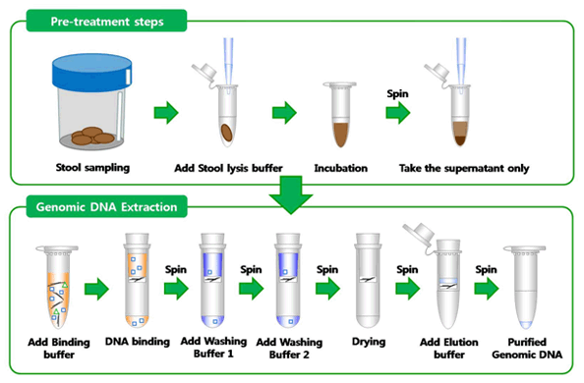
DNA Isolation and Purification from stools/saliva or any source

Slide 30
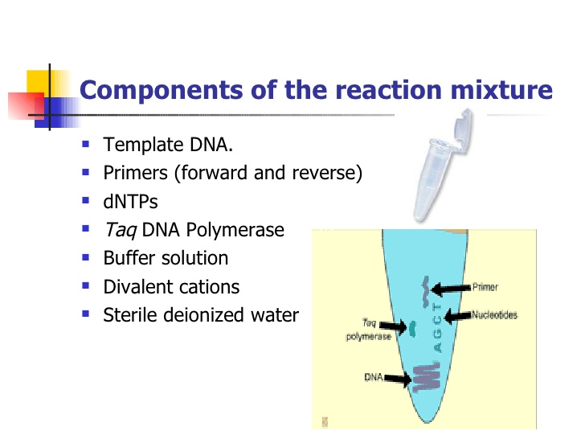

Slide 31

Thermal Cycler for PCR

Slide 32


Slide 33


Agarose Gel Electrophoresis

Slide 34

DNA Sequencing
This PCR product is used for sequencing
Sequencing will be done at the genomic lab in Feinstein
  Illumina Next-Gen sequencing machine

Slide 35

Thank You
Questions?
References or citations for images and data within this presentation are available upon request.

Slide 36
Contact Us:
Mabel N. Abraham, PhD
  Mabraham11@northwell.edu
Champa N. Codipilly, PhD
  Ccodipil@nothwell.edu
Julien Papoin, MS
Jpapoin@northwell.edu

